Slide 1
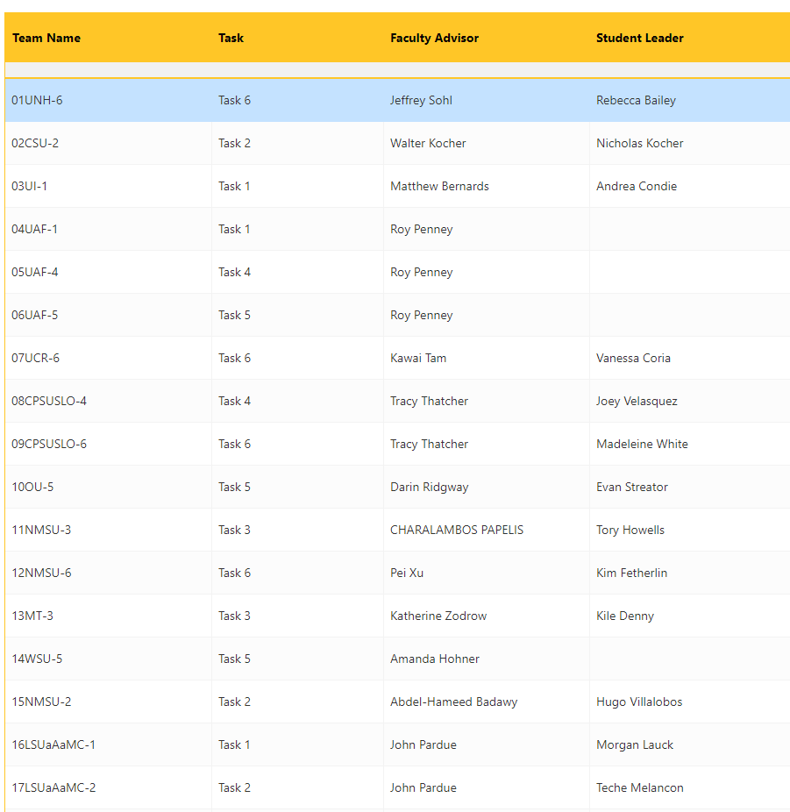

Submission Status
Approval Status

Slide 2



Experiment Scope
Drawing of the Experimental Layout including P&ID
Normal Operations, Startup and Shutdown Procedures
Emergency Shutdown Procedure
Waste Management Procedure
Hazard Identification
Material Safety Data Sheets

Slide 3
Experiment Scope
Approve
Text editor: write their Experiment Scope
Write the comment:
Send an email
Save to review
Drawing of the Experimental Layout including P&ID
Normal Operations, Startup and Shutdown Procedures
Emergency Shutdown Procedure
Waste Management Procedure
Hazard Identification
Material Safety Data Sheets

Slide 4



Experiment Scope
Drawing of the Experimental Layout including P&ID
Approve
Instructions
Attached File
Process explanation(Optional)
Write the comment:
In review
Normal Operations, Startup and Shutdown Procedures
Emergency Shutdown Procedure
Waste Management Procedure
Hazard Identification
Material Safety Data Sheets

Slide 5
Experiment Scope
Drawing of the Experimental Layout including P&ID
Normal Operations, Startup and Shutdown Procedures
Instructions
Text editor: write their Experiment Scope
Write the comment:
Emergency Shutdown Procedure
Waste Management Procedure
Hazard Identification
Material Safety Data Sheets

Slide 6
Experiment Scope
Approve
Disapprove
Drawing of the Experimental Layout including P&ID
Normal Operations, Startup and Shutdown Procedures
Instructions
Text editor: write their Experiment Scope
Write the comment:
Emergency Shutdown Procedure
Waste Management Procedure
Hazard Identification
Material Safety Data Sheets

Slide 7
Experiment Scope
Approve
Disapprove
Drawing of the Experimental Layout including P&ID
Normal Operations, Startup and Shutdown Procedures
Emergency Shutdown Procedure
Instructions
Text editor: write their Experiment Scope
Write the comment:
Waste Management Procedure
Hazard Identification
Material Safety Data Sheets

Slide 8
Experiment Scope
Approve
Disapprove
Drawing of the Experimental Layout including P&ID
Normal Operations, Startup and Shutdown Procedures
Emergency Shutdown Procedure
Waste Management Procedure
Instructions
Text editor: write their Experiment Scope
Write the comment:
Hazard Identification
Material Safety Data Sheets

Slide 9
Experiment Scope
Approve
Disapprove
Drawing of the Experimental Layout including P&ID
Normal Operations, Startup and Shutdown Procedures
Emergency Shutdown Procedure
Waste Management Procedure
Hazard Identification
Instructions
Attached File
Process explanation(Optional)
Approve
Disapprove
Write the comment:
Material Safety Data Sheets

Slide 10
Experiment Scope
Approve
Disapprove
Drawing of the Experimental Layout including P&ID
Normal Operations, Startup and Shutdown Procedures
Emergency Shutdown Procedure
Waste Management Procedure
Hazard Identification
Material Safety Data Sheets
Instructions
Attached File(s)
Process explanation(Optional)
Approve
Disapprove
Write the comment:

